Slide 1

Introduction to Linux

Slide 2
Why Linux
Carrier oriented course.
One of the secure OS.
Website development and hosting
Sharing of H/W and S/W with other OS.

Slide 3
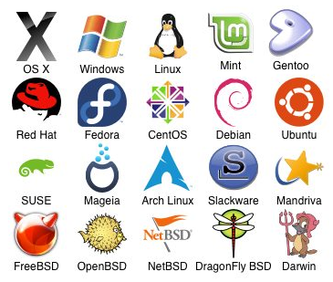
Before we learn Linux, let’s understand:
What is an Operating System?

Slide 4
Kernel
Kernel is responsible for the communication with the hardware, and it is actually the part of the operating system that talks directly with the hardware.
All other parts that make up the operating system (graphical user interface, file management, shell, etc.) rely on the kernel.

Slide 5
UNIX
In 1969, a team of developers in the Bell Labs laboratories developed a new operating system which was
Simple and elegant.
Written in the C programming language instead of in assembly code.
The Bell Labs developers named their project "UNIX.“
Linus Torvalds used to work on the UNIX OS and thought that it needed improvements. When his suggestions were rejected by the designers of UNIX, he thought of launching an OS which will be receptive to changes, modifications suggested by its users.

Slide 6
LINUX
Linux is an operating system or a kernel which germinated as an idea in the mind of young and bright Linus Torvalds when he was a computer science student.
Linus designed a Kernel named Linux in 1991.
There is not much difference between UNIX and Linux. Linux is a clone of UNIX.
Linux powers 94% of the world’s
Supercomputers
most of the servers powering the Internet
the majority of financial trades worldwide
Linux is free
Linux has attractive features and performance
Linux is secure
Linux is an alternative for Microsoft Windows
Linux is anti-Microsoft

Slide 7
Linux Distribution
Almost six hundred Linux distributions exist.
Red Hat
Fedora
Ubutu
Mandrive
Mint
SUSE

Slide 8

The course contents
Introduction to OS
Installation process
Disk partitioning
Creation of groups and user accounts
Desktop handling
Software installation
Different types of server handling
Authentication to users and files.

Slide 9
Course Outcome…
By the end of the CAP652 every one of you would have learn the following:
Security systems
File and System sharing
Web Site hosting.

Slide 10
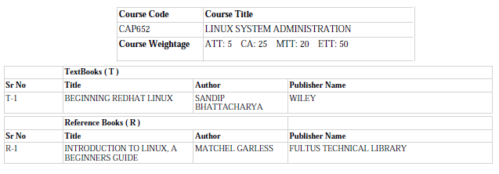
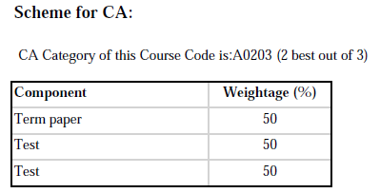

Slide 11
More than 90% of current Linux source code is written by other developers (and not Linus Torvalds himself)
Most of the Super Computer's use Linux. And the numbers are growing on a yearly basis
Android’s Operating System is based off of Linux. There are more than 10 Linux based Mobile operating System's. Normally people think Android is the only operating system that's based on Linux. However there are more than 10 mobile operating system's based on Linux. OpenZaurus, Firefox OS, Sailfish OS, Ubuntu Touch, Ubuntu Mobile, Mobline etc are a few apart from Android.
Google has its own Linux Distribution for its internal Employees. Its called Goobuntu. Its not currently available for general public.
Steve Jobs once offered (in 2000) a job to Linus Torvalds at Apple but Linus rejected the offer.

Slide 12
For those who think Linux can’t do Animation – Oscar-winning visual effects of the Titanic by James Cameron came from machines with Linux and Avatar was the last movie completely developed in 3D Applications on Linux platform using Foss Software.
Open Source and Free Software, both are different
Only 2% of today’s kernel contains code written by Torvalds.
Debian was one of the first GNU / Linux that was constituted and organized as a community of developers. Debian’s code base remains the foundation for other distros such as Ubuntu, Knoppix and Xandros.
Top ten of supercomputers use Linux. 33.8% of the world runs on Linux servers compared to 7.3% running Microsoft Windows operating system.
Server hosting the website: Google, Cisco, Facebook, Twitter, Linked in

